Slide 1
Email Classification By Machine Learning
Will Smith
Melika Shekarriz
Adam Ismaili

Slide 2
Outline
Introduction
Methodology
Data Exploration
Future Optimization
Conclusion

Slide 3
Introduction
What is classification?
A technique to categorize our data into a desired and distinct number of classes
Email classification as an application of classification
Goal: Classifying emails as personal or promotional
Best results with Decision Tree!

Slide 4
Methodology
Decision Tree
Makes decision with tree-like model.

Slide 5
Data Exploration
Two datasets were provided to our team
Step 1 : Sample code (.23423)
Step 2 : Decision tree without date, org, mail_type, tld (.98029)
Step 3 : Same as above minus designations field (from powerset test) (.97855)
Step 4 : All fields but date included now, still a tree (.99146)
Step 5 : Logistic regression attempt (.93292)
Step 6 : Multilayer perceptron attempt (.78412)

Slide 6
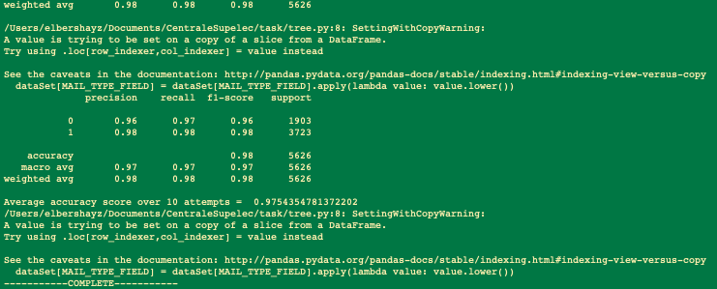

Slide 7
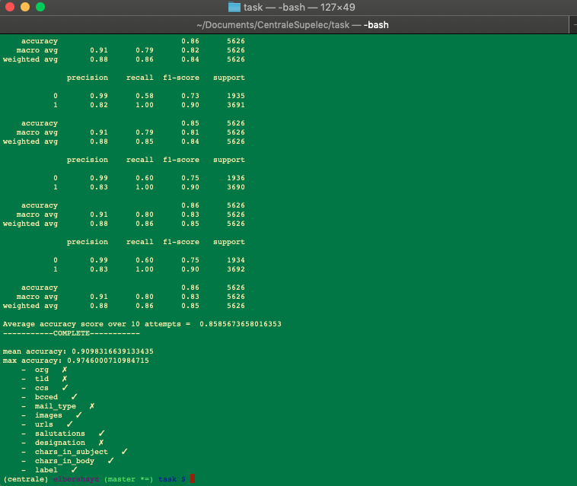

Slide 8
Future Optimization
Random Forest
Include date column

